Slide 1

Lenskart CS Hiring Presentation

Slide 2
Process Flow For Student

Slide 3
Student
Web Page
Careers Page
Login
SignUp
Apply
If Not Pass Threshold
Student Dashboard
Resume Filter
Reject
If Pass Threshold
Get Test Link
Pass Test Threshold
Interview
Pass Interview Threshold
Select

Slide 4
Threshold Value

Slide 5
Threshold Key | Threshold Value
Resume Threshold | 18 /100 (analysis by the + and - resume)
Test Threshold | 40% in each and total score also 40%
Interview Threshold | 75

Slide 6
Process For HR

Slide 7
Login
HR
Web Page
SignUp
Dashboard
Post Job
Referral Candidate
Manage Job’s
Manage Register Candidate
Forward Candidate
Modify Candidate Score
Schedule Interview
Reject Candidate

Slide 8
Website View

Slide 9
Home Page

Slide 10


Slide 11
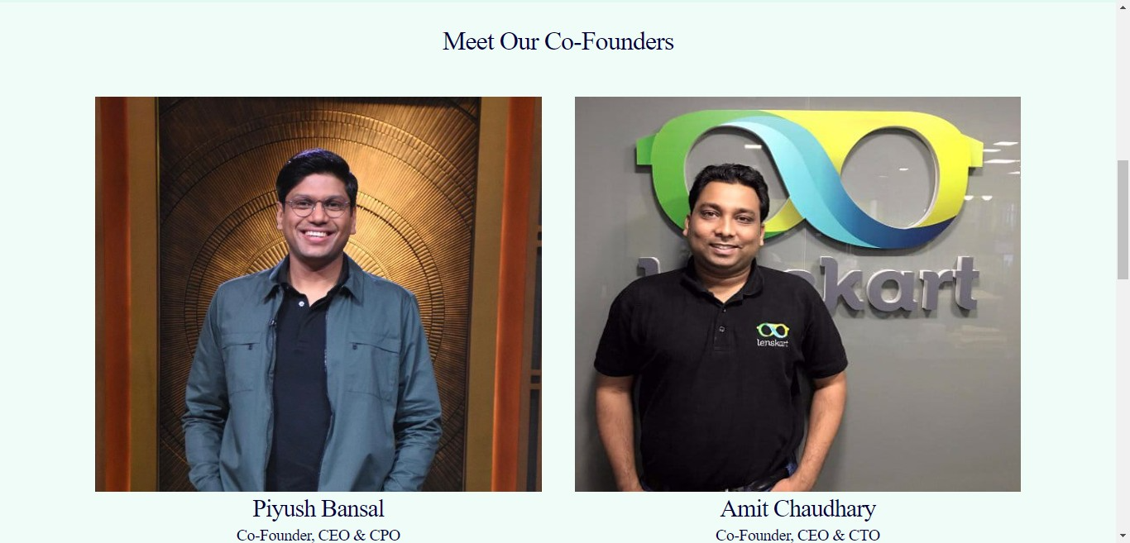

Slide 12


Slide 13


Slide 14
Careers Page

Slide 15
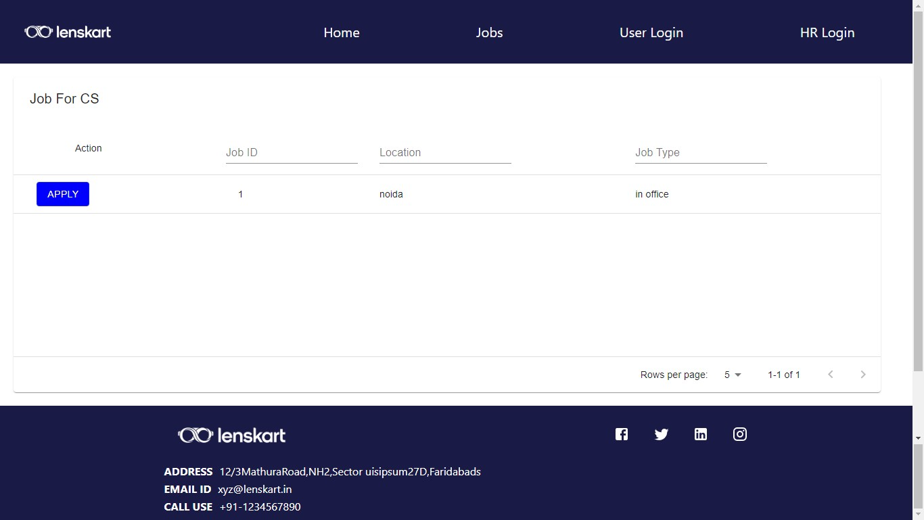

Slide 16
Login and SignUp

Slide 17
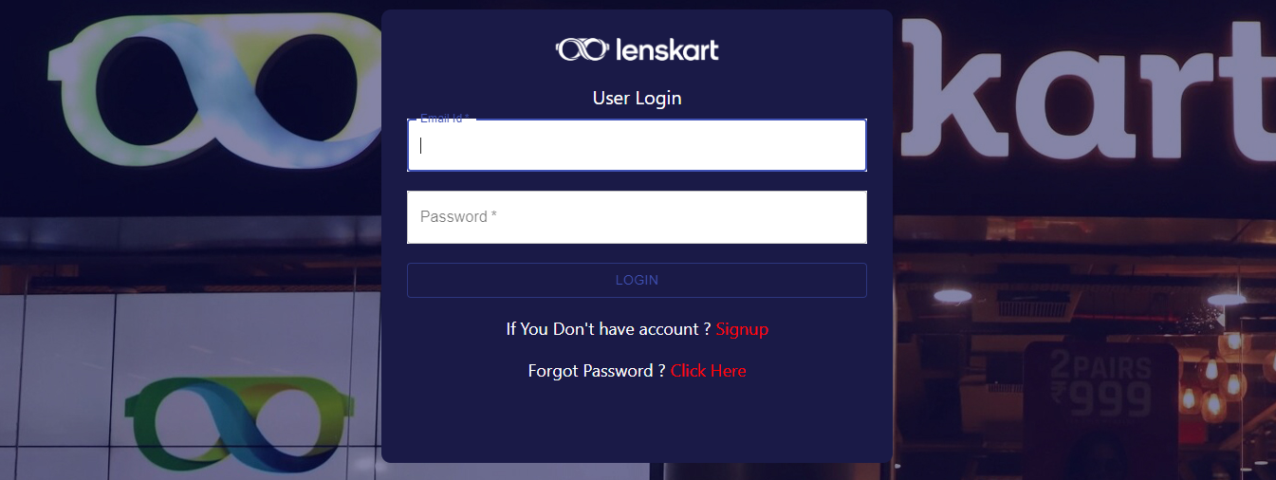

Slide 18
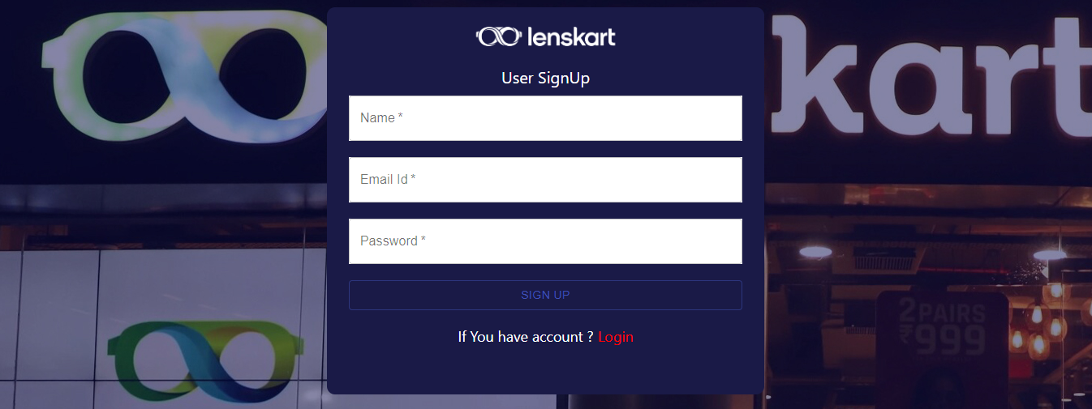

Slide 19
Candidate Dashboard

Slide 20
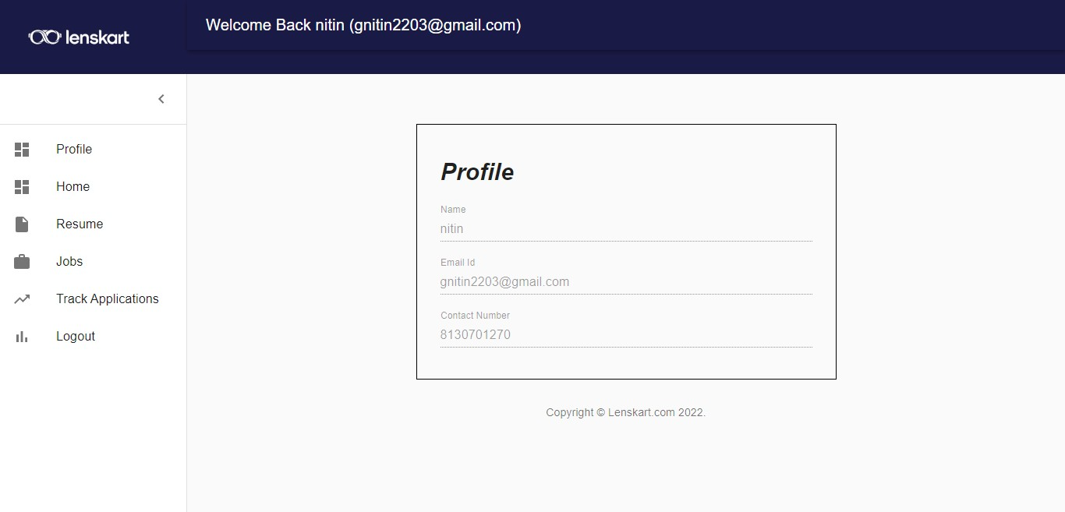

Slide 21
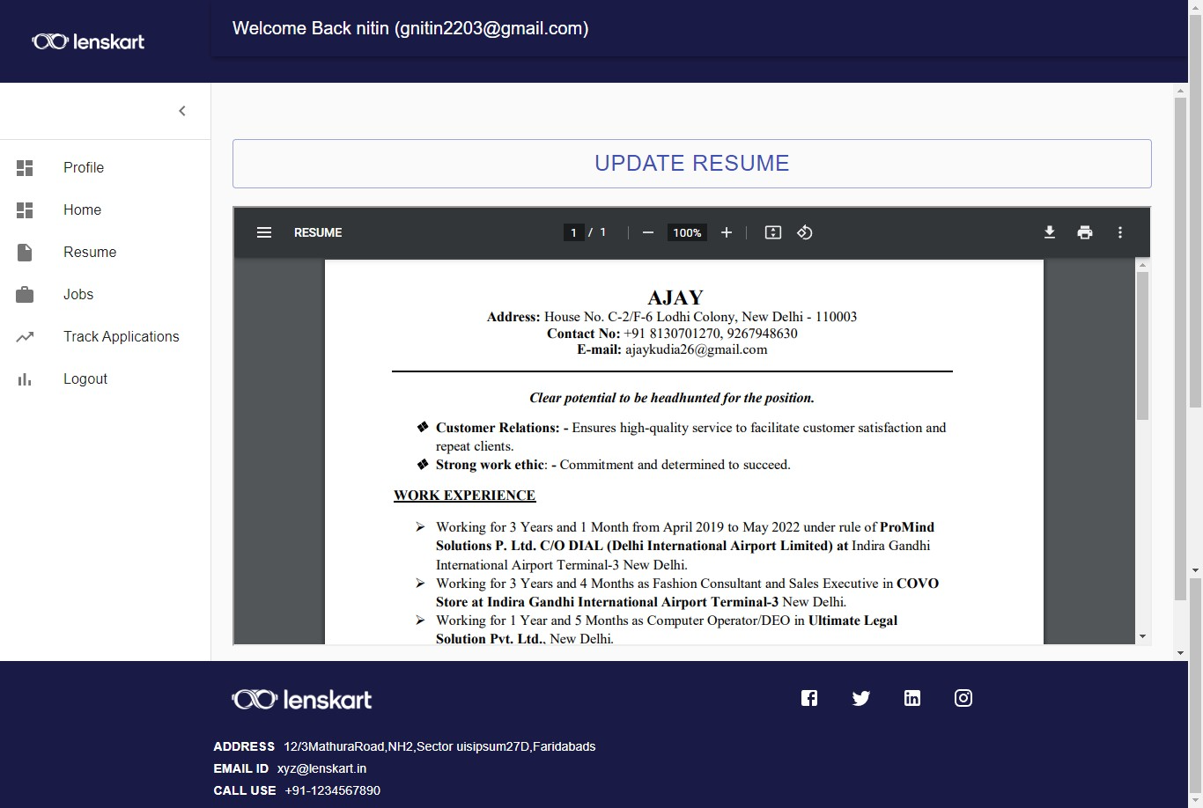

Slide 22
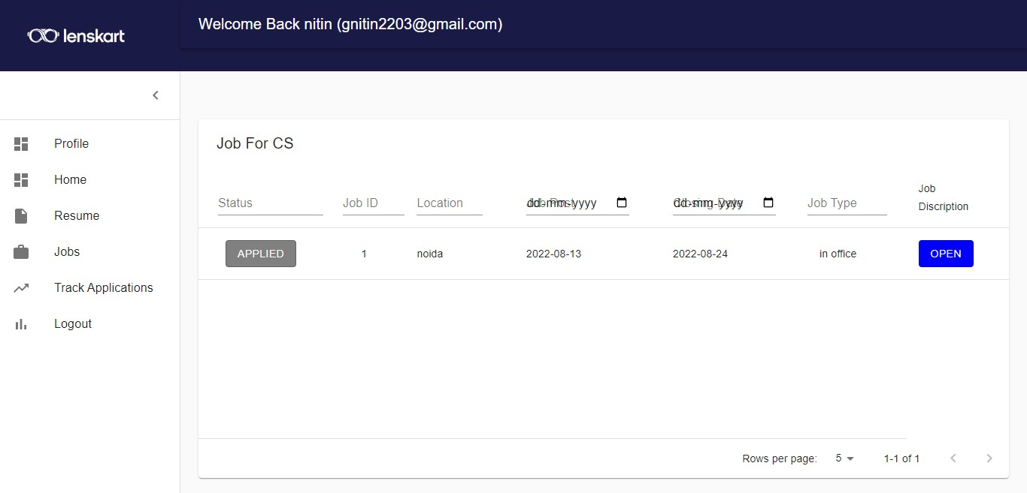

Slide 23
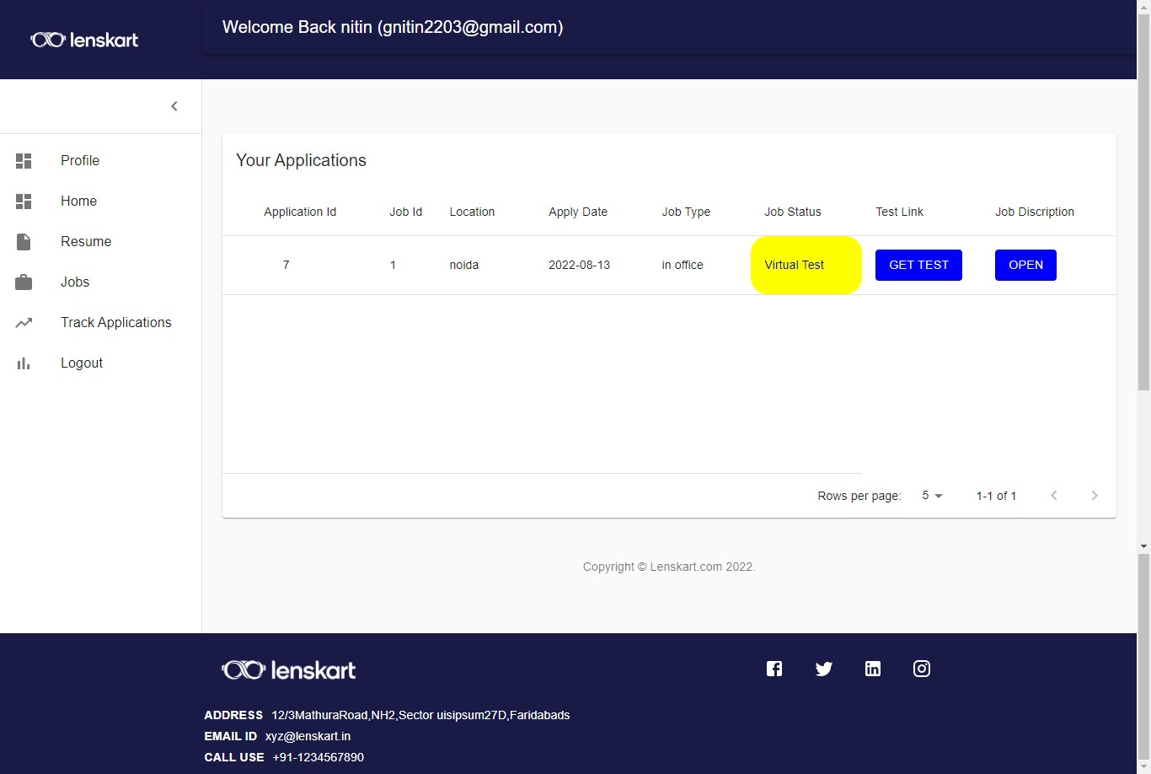

Slide 24
HR Dashboard

Slide 25
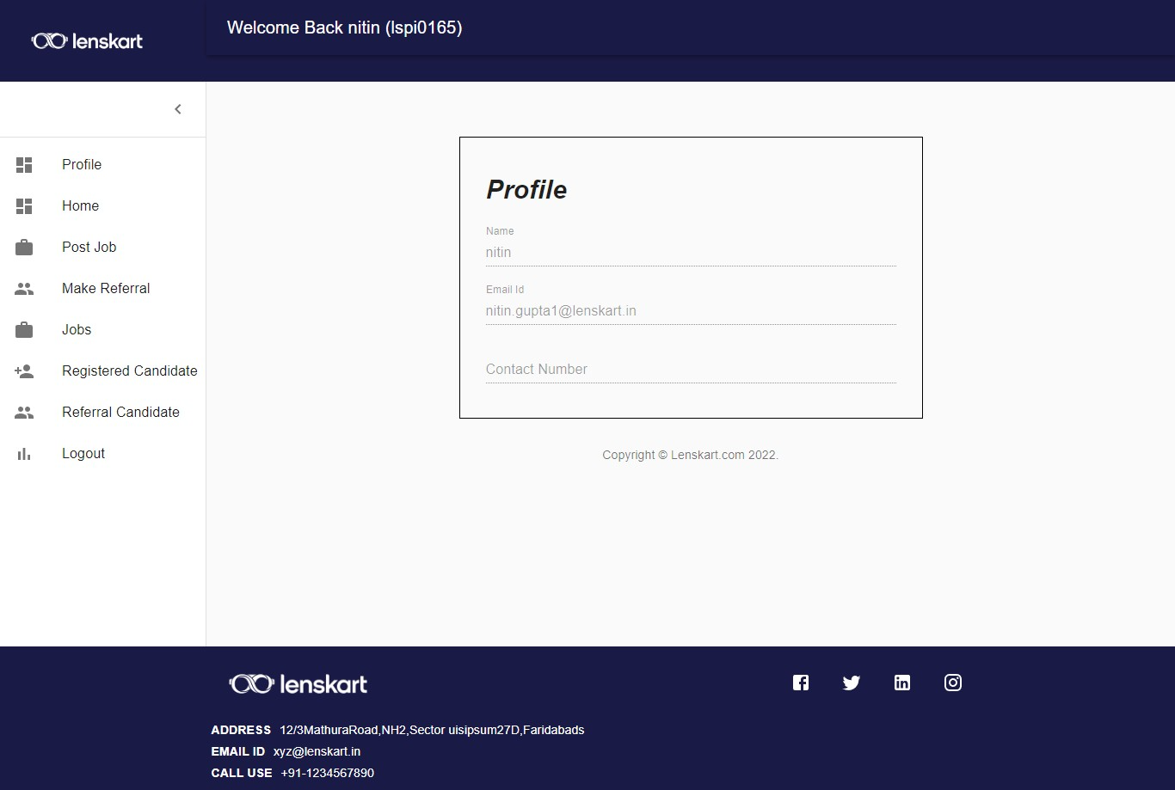

Slide 26
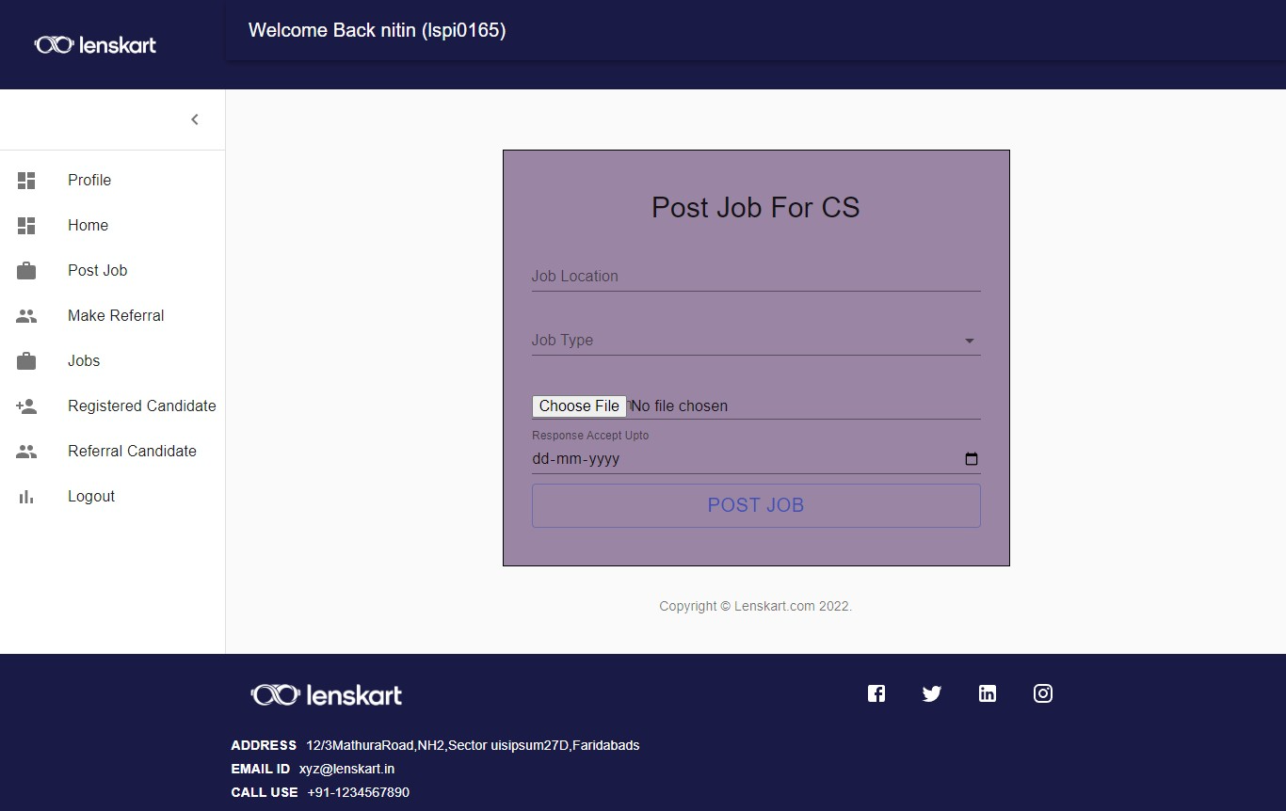

Slide 27
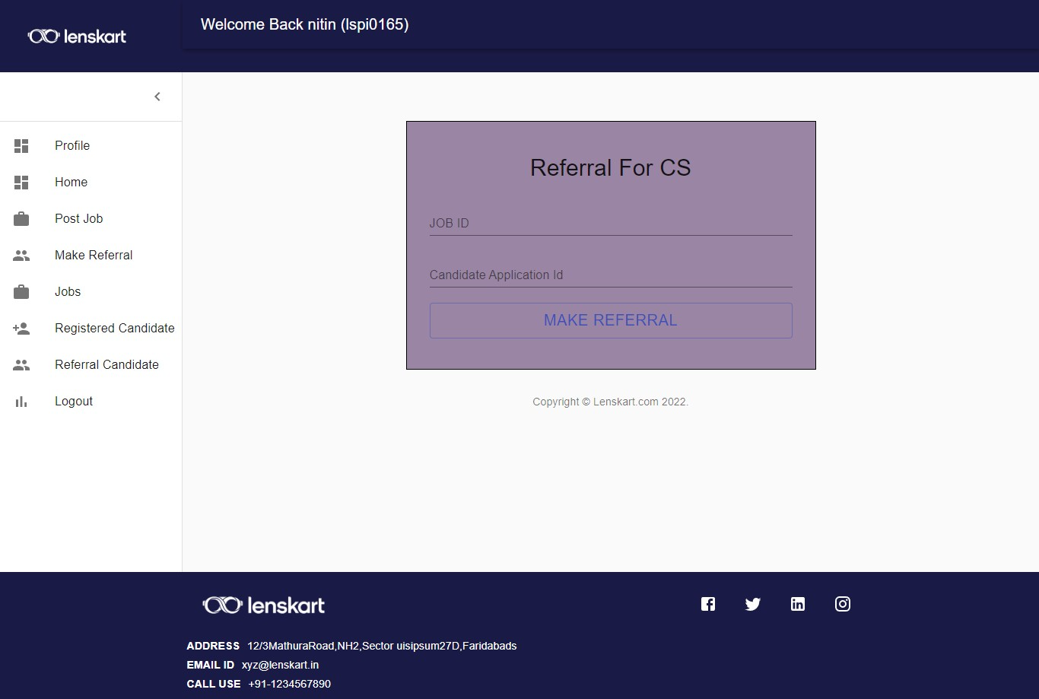

Slide 28
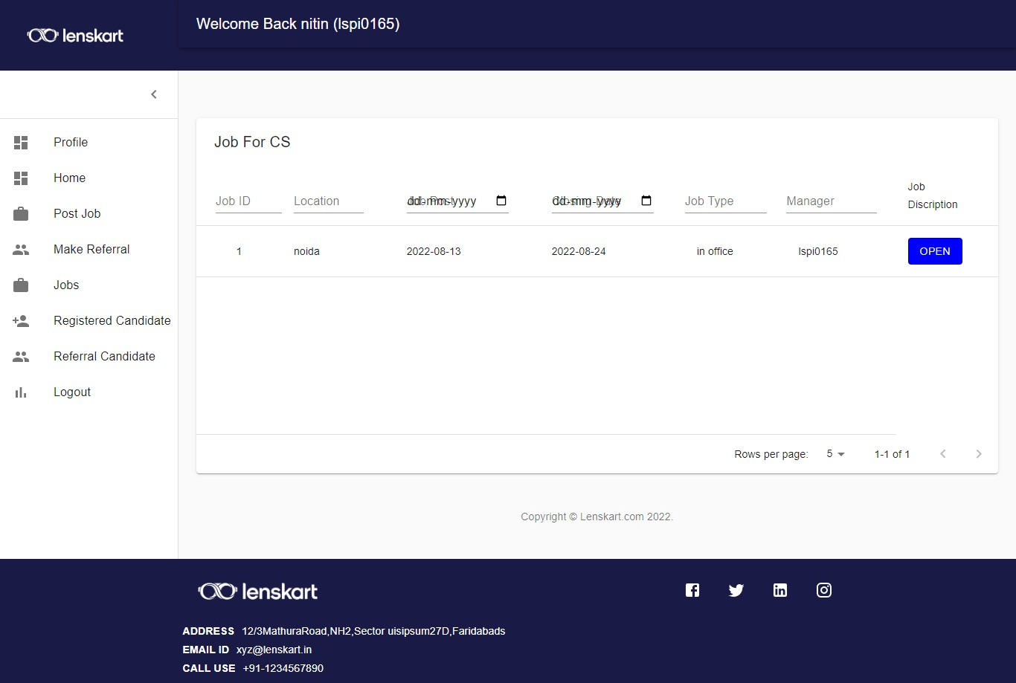

Slide 29
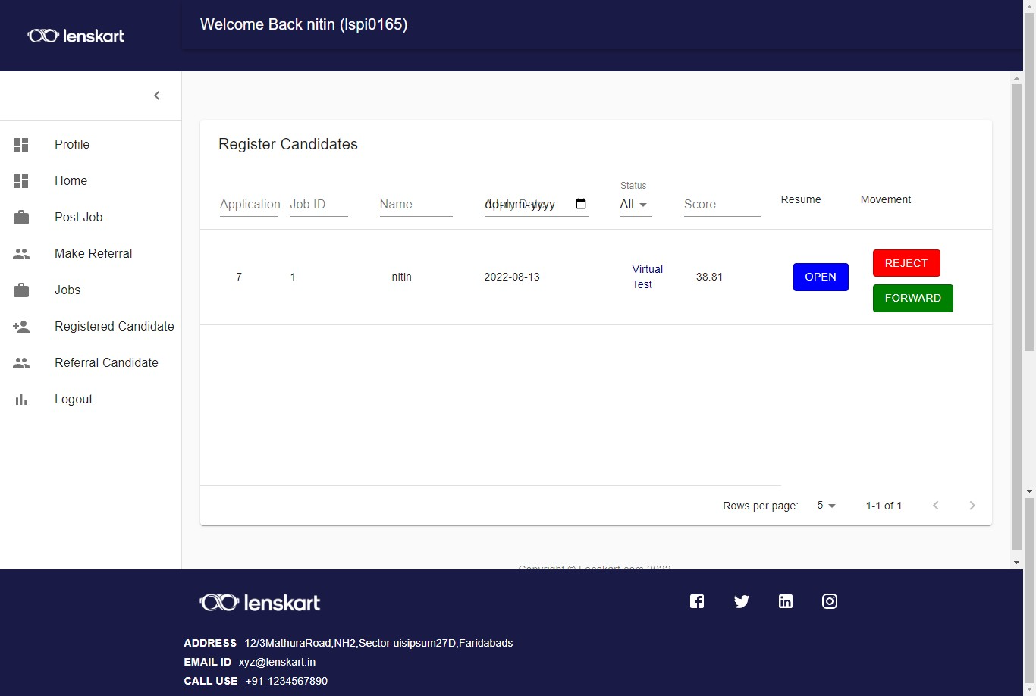

Slide 30
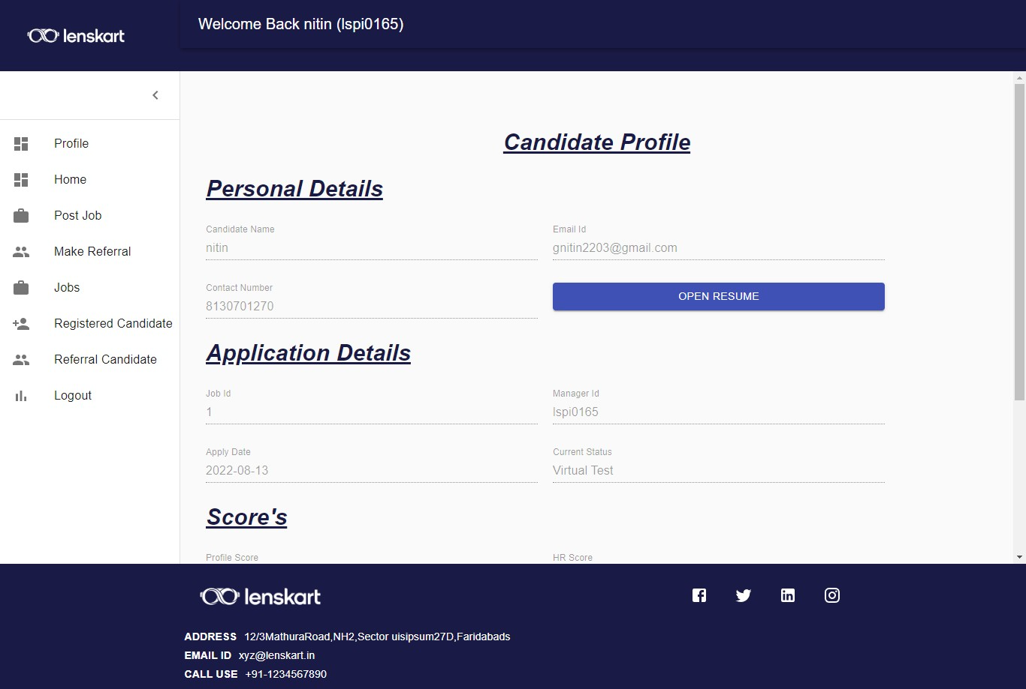

Slide 31
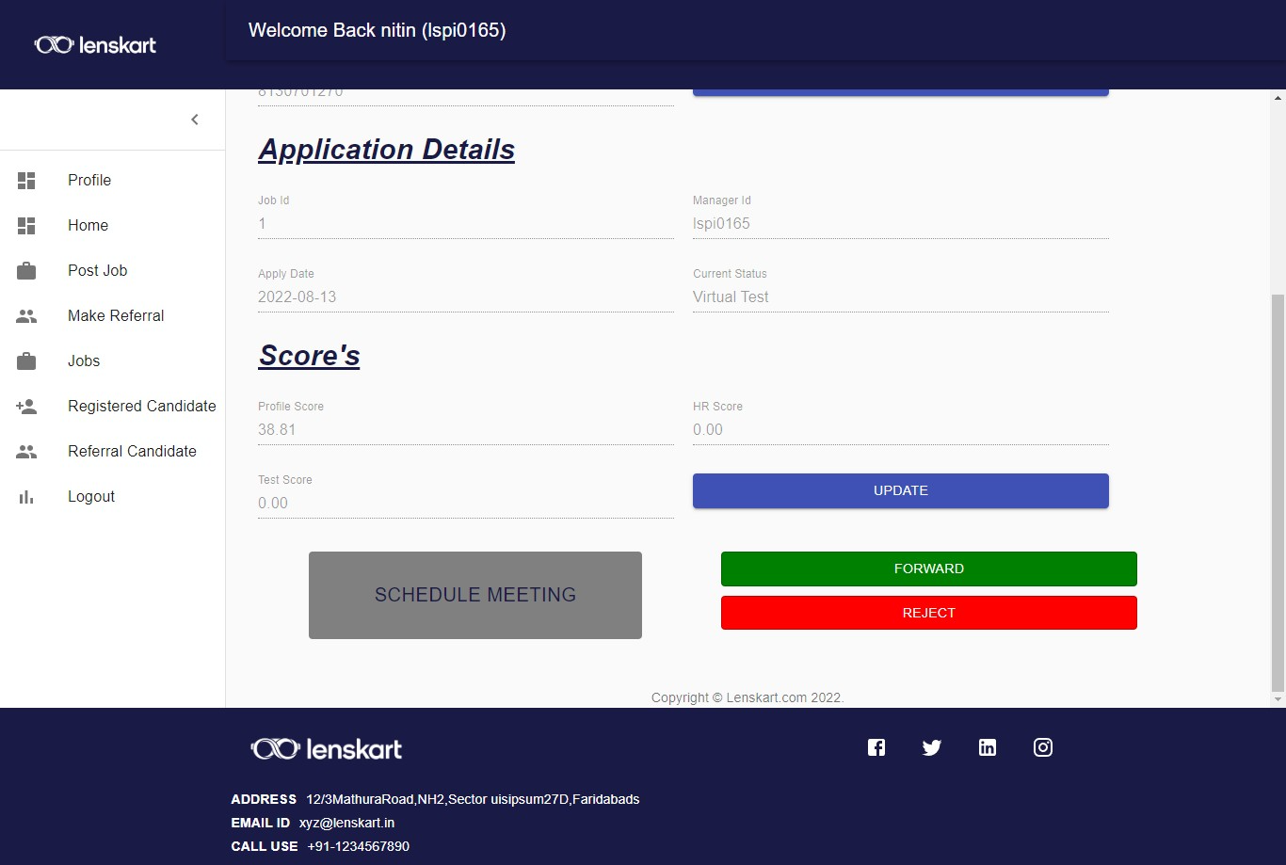

Slide 32
END

